Slide 1
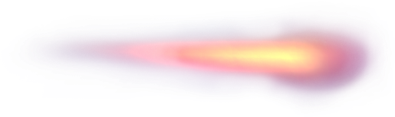
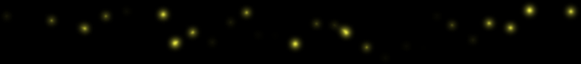
Decentralized
LLM
Tengfei Ma
Yifu Tian
Ruolan Shi

Slide 2

行业PPT模板http://www.1ppt.com/hangye/
CONTENT
1
2
3
Background & What is deLLM? Incentive
Motivations

Slide 3

1
Background & Motivations

Slide 4
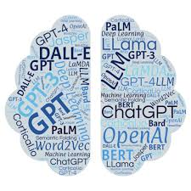

Large language models (LLM)
A type of artificial intelligence (AI) algorithm that uses deep learning techniques and massively large datasets
Serve as a fundamental building block of natural language processing (NLP)
75%

Slide 5

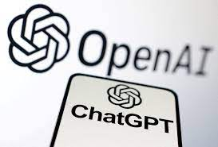
Large language models (LLM)
If one unit decides to shut down the model, it cannot be used anymore.
Some dishonest units may design their own models and feed them unhealthy training data.
All
Centralized
75%

Slide 6

Try Decentralized!
Go Decentralized
Everyone Gives, Everyone Gains!
75%

Slide 7
Motivations
Everyone can contribute data
Gather everyone’s training results
Prevent single point of failure of platform
Vast and diverse training dataset are used
No one can take down the work from you!
Data
Training
Stability
Fairness
Anti-monopoly

Slide 8
2
What is deMLL
Everyone contributes and uses

Slide 9
Blockchain
Block
The blockchain is like Bitcoin
except the content.
Adopt PoW, but mining makes person have right to train.
UniqueID:
Author: (Address)
Parameters:
Previous block hash value:
Training data: (size range)
(data may be marked by copyright）
Model: (eg. Tansformer)
Time: (protect ownership)
Nonce:
All attributes are public.

Slide 10
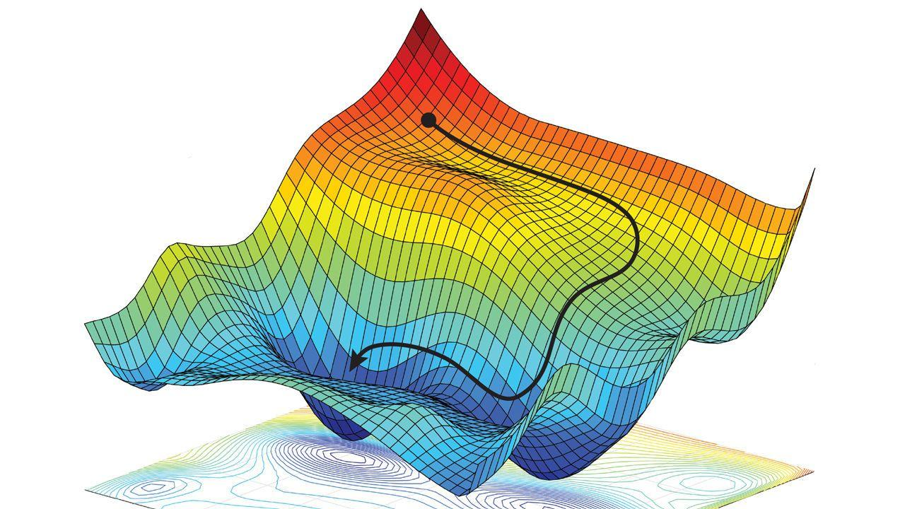
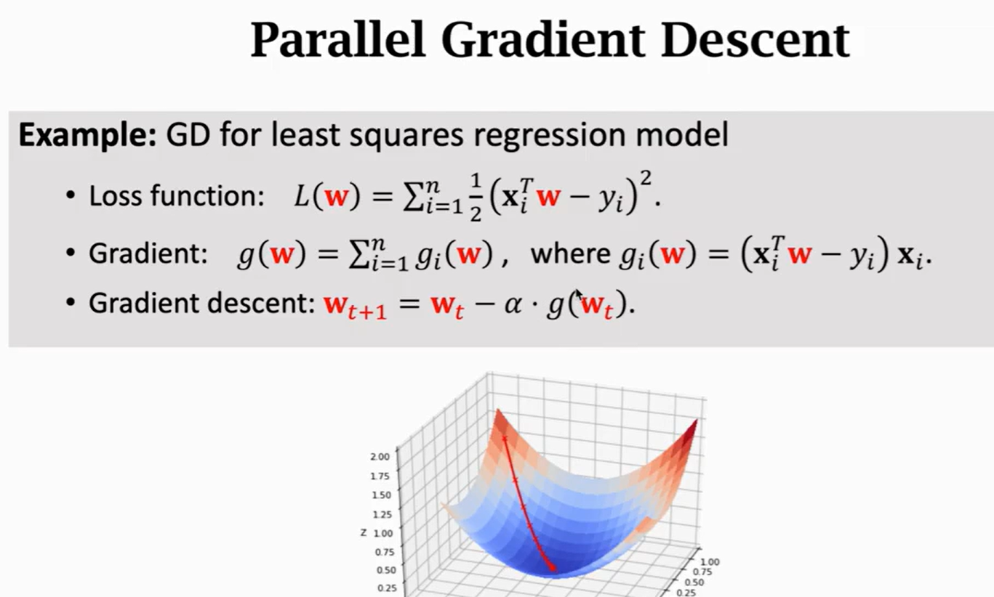
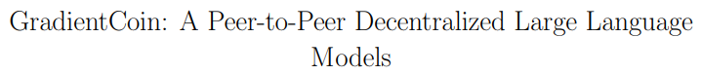
Training
Block
Convergence: https://arxiv.org/pdf/2308.10502.pdf

Slide 11

Incentive
Lack of Incentive Mechanism
Single Point of Failure
Control over Data
:

Slide 12
Incentive
Definition
User: A user can play any role of a founder, original contributor, or follower.
Founder: In the data chain A-B-C-...-X, A is the founder.
Original Contributor: In the data chain A-B-C-...-X, all blocks preceding X are original data blocks.
Follower: In the data chain, all data blocks following the founder.

Slide 13
Incentive
Method:
If you train, you own your block(NFT). If any profitable application using some block, the block and the previous blocks of it should be paid.
Potential Problem:
Profit Distribution

Slide 14
Incentive
The profit distribution is decided by the founder.
Founder A needs to propose a profit-sharing plan.
If contributor B thinks this plan is good, they will link their data block to A's data block.

Slide 15
Thanks !

